Slide 1
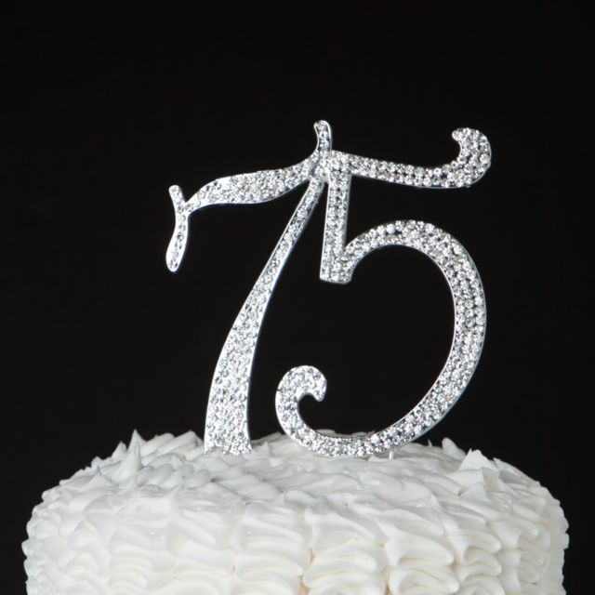
You’re invited to help celebrate a milestone in 35 Squadrons History
Formal Attire or
Mess Dress equivalent.
Entertainment by
the Army Band.
$30.00: Social Club members.
$60.00: Non-Club members, partners, 35SQN Association members & external Guests.
RSVP: 25 Aug 2017
th
Anniversary Ball
at The Lyceum Room, Castle Hill RSL ~ 15 September 2017, 1800 – 2300h ~
Email enquiries & RSVP’s to: ric35sqn75th.birthday@defence.gov.au

